Slide 1
Summary
Baselines: Come from randomizing 10000 sequences by sequence distribution in membrane and calculating energy score for each type
Uses both H-bonding and vdW as energy terms
3 Types of baselines:
Original: calculate the energy of each AA and it’s interactions with the rest of the protein
Baseline by Position: Same as above, but take the average for each position rather than for an AA anywhere in the protein
Self + Pair: Calculate energy of AA + energy of each individual interaction with all other AAs on the protein

Slide 2
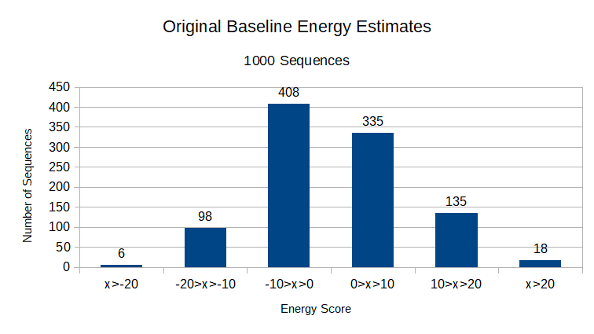
Mean = 0.55
SD = 8.71
Smallest = -25.05
Largest = 27.89

Slide 3
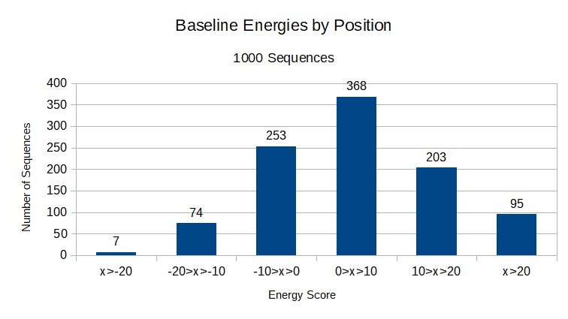
Mean = 4.80
SD = 11.31
Smallest = -97.87
Largest = 41.06

Slide 4
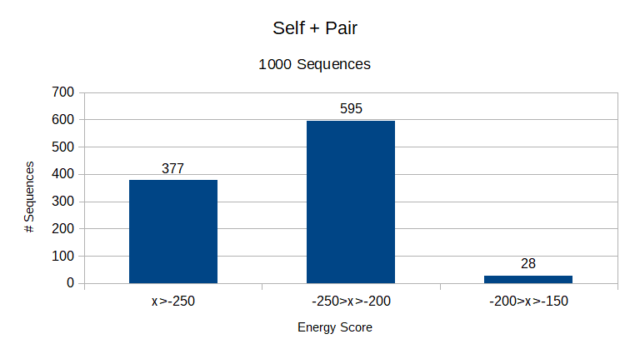
Self + Pair: Didn’t work well at all
All compared values were >-100 worse than the actual calculated energy
Some really poor values that occur from clashing, but even when removing those it still doesn’t lead to good energies
Mean = -242.54
SD = 22.49
Notes:
Plan to look into my code to see if I did something strange; not a consequence of lower numbers of interactions either (can pull up data if need be); could it be a consequence of not calculating the pair value backwards and only forwards? I don’t think so because I did a check where just getting those forward energies led to recapitulating the energy

